Slide 1

Agenda
ISO 20022 Refresher
Who is using ISO 20022?
ISO 20022 in practice
How to get the best out of two worlds?

Slide 2
The ISO 20022 specification
Part 1: Metamodel
Part 2: UML profile
Part 3: Modelling
Part 4: XML Schema generation
Part 5: Reverse engineering
Part 6: Message transport characteristics
Part 7: Registration
Part 8: ASN.1 generation
Implemented by the ISO 20022 Standards editor

Slide 3
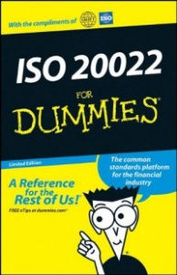
What is ISO 20022?
www.iso20022.org
single standardisation approach (methodology, process, repository)
to be used by all financial standards initiatives
Recipe to create financial standards
Body of content
Business models
Data dictionary
Catalogue of messages
Business / Conceptual
Logical
Physical
Defines business meaning of financial concepts, e.g., ‘Credit Transfer’
Defines e.g. credit transfer messages, to execute the business process
Defines physical syntax, e.g. XML

Slide 4









www.iso20022.org
Using ISO 20022 modelling to
reach interoperability
Date
Account
All users have their own sets of data objects
Order
ISO standardizes common data objects…
Order
Date
…and groups them into ‘syntax-neutral’ message models, which...
Date
… can be ‘transformed’ in message formats in the desired syntax
XML
ASN.1
JSON?
Notes:
As explained earlier, the pillar of the ISO 20022 methodology is the central dictionary of common business concepts and the modelling methodology used to assemble them in syntax-neutral message models. These message models are the ‘business’ standards approved by the SEGs.
Thanks to the central dictionary, all the ISO 20022 message models share a common understanding and representation of business concepts which helps the business information to flow smoothly from one message to the other along the transaction life cycles, even if the syntax used to identify and format these concepts in the ‘physical’ messages is different.

Slide 5
Advantages of ISO 20022
Global
standard
to meet local
needs
Open
standard
End-to-end
automation
Mainstream
technology
Future-
proof
Open to everyone,
not controlled
by a single
interest
A single standard that covers all business domains and
end-to-end
business processes
Uses
mainstream,
well-supported
technology
(e.g. XML) that
facilitates efficient integration
Can adapt to new technologies
as they emerge
Rich, structured standard that allows definition of formal market practice
Notes:
An open standard, not controlled by a single interest, and open to participation from its user community;
Scope covers the entire financial industry, so consistent end-to-end business processes can be realized via a single standard;
Uses modern, mainstream, well-supported technology;
XML
Unicode (supports non-Latin characters)
Can adapt to new technologies as they emerge - ‘future-proof’;
A global standard to meet local needs
Formally defined Market Practice

Slide 6
ISO 20022
The registration process (1/2)
R
M
G
m
o
n
i
t
o
r
s
Submitting
organisation
Financial industry group or standards body
Business
justification
Business justification
Project approval & allocation to a SEG
RMG
Submitting organisation
& RA
Development & provisional registration
Business validation
SEG
Official registration
and publication
RA
Repository
Dictionary
Submitting organisation
& users
Optional pilot testing
or first implementers
Catalogue
www.iso20022.org
Notes:
This is an illustration of the process for development and registration of new sets of messages. There is a more detailed description of it on http://www.iso20022.org/development_and_maintenance.page.
1) The entry point of the registration process is the preparation of a ‘Business Justification’ by the organisation that wants to develop the messages (the “submitting organisation”). The Business Justification must describe the high level scope of the messages to be developed and the reason why they are needed. It must identify the communities of potential users and the kind of benefits that these potential users are expected to enjoy. To the extent possible, the submitting organisation will also give a concrete idea of the estimated number of users and volume of messages, as well as the expected benefits or savings for the industry. Finally, the submitting organisation will give some indication about the other organisations that will be involved in the development and the development timing. A template for the Business Justification is available for download from the ISO 20022 website. The Business Justification is normally a ‘high level’ justification, which is introduced by the submitting organisation before starting the actual development. Therefore, it is not expected to include a detailed description of the future messages, which will only be available after the modelling.
2) The Business Justification is reviewed by the SEG(s) and the RMG. The RMG will decide whether the proposed development fits into the ISO 20022 spectrum, does not duplicate already existing messages and is indeed beneficial to the community. If the request is approved, the RMG decides which SEG(s) will be in charge of the evaluation of the messages, once developed. When the workload of the SEG(s) and/or the RA is high, the RMG decides on the priority of approved submissions.
3) The submitting organisation starts developing ISO 20022 compliant business and message models. The RA assists the submitting organisation during this phase in order to ensure that the models are compliant and use the right components from the Data Dictionary. If need be, additional ‘provisionally registered’ components are created. When the development is completed, the RA generates the XML or ASN.1 schemas and, with the submitting organisation, prepares a comprehensive documentation for the SEG. The documentation includes the full description of the message formats, the XML or ASN.1 schemas and some examples.
4) Based on this documentation, the SEG(s) evaluates the candidate ISO 20022 messages. The main goal of the SEG(s) is to get the buy-in of the future users from a business perspective. The submitting organisation is participating to the evaluation to help the SEG understand the proposed solution and address any question that would be raised by the SEG members.
5) When/if the SEG approves the messages, the RA officially registers new components in the ISO 20022 Data Dictionary and publishes the new ‘ISO 20022 messages’ in the Catalogue of ISO 20022 messages on www.iso20022.org.
6) When messages are first piloted or implemented, first users are invited to comment on the ‘technical implementability’ of the messages and the accuracy of the documentation published on the website. Possible changes or corrections requested by first implementers will be evaluated by the SEG, the RA and the submitting organisation and may lead to changes to the messages and/or documentation.
All along, the RMG monitors the work and if need be, arbitrates any disputes.

Slide 7
ISO 20022
The registration process (2/2)
R
M
G
m
o
n
i
t
o
r
s
Submitting
organisation
Financial industry group or standards body
Business
justification
Business justification
Project approval & allocation to a SEG
RMG
Candidate ISO 20022 messages
Submitting organisation
& RA
Development & provisional registration
Business validation
SEG
ISO 20022 messages
Official registration
and publication
RA
Repository
Dictionary
Submitting organisation
& users
Optional pilot testing
or first implementers
Catalogue
www.iso20022.org
Notes:
Once the Business Justification is approved by the RMG, and as long as the messages have not been approved by the SEG, the messages are called ‘candidate ISO 20022 messages’. Once they are approved by the SEG for publication, the messages are called ‘ISO 20022 messages’ or ‘ISO 20022 compliant messages’.

Slide 8
Standards are created globally and used locally: market practice and variants
‘PACS’-pacs.008.001.04
FI to FI Customer Credit Transfer
ISO 20022 messages
Global market practice
Local market practice
Bank-specific practice
HVP-guidelines
T2 implementation
guidelines
Bank’s T2 implementation
with customers/bank’s
internal specification
Notes:
Market practice is Derived from/consistent with base standard [ISO 20022 messages]
Market practice is necessary to adapt global standards to local needs – is a healthy sign!!
SWIFT has relevant expertise and tools to manage market practice [see slide later in the presentation]
A new MX message starts by default with version 01. When a message has gone through the maintenance cycle it will be upgrade to the next message version.
A new message version of an MX has a version number that is part of the MX name and an identifier increment.
Usage Guidelines:
Usage guidelines (such as global or local Market practices) is always in line with the base message. Institutions can develop their own Usage Guidelines as part of internal and/or customer specifications or as part of a market practice organization. They are based on a bi- or multilateral agreement in between the parties exchanging the messages to stick to the defined guidelines.
Note: extensions are not shown here, can be added when talking to relevant audience.

Slide 9
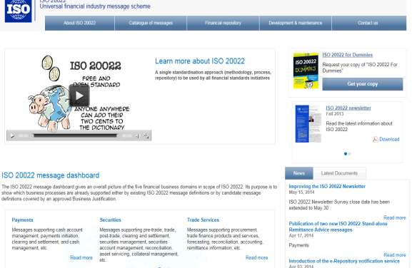

www.iso20022.org
Maintenance process – built on strict business justifications and review process - leading to new ‘versions’ of the messages
ISO 20022 message
catalogue
More than 320 ISO 20022 messages
More than 320 messages, covering payments, securities, trade services, FX, cards
More than 20 submitting organisations
EXAMPLE
‘PAIN’ = Payment initiation = used in Corporate-to-bank
‘PACS’ = Interbank clearing and settlement = used in HVP and LVP MI
‘SESE’ = Securities settlement = used in Securities MI
‘SEMT’ = Securities management = used in Securities MI
18 business areas
9
Notes:
NBB (for 7 CBs)
ISDA/FPML
Berlin Group
ANBIMA
ASF
Federation of Finish Financial Services
China UnionPay
Clearstream
Euroclear
EPASOrg
OMGEO
UN/CEFACT
FR SWIFT UG
4CB
ISOTC68/SC4/TGI
SWIFT
IFX
OAGI
TWIST
ISITC
FPL
CBI
CLS

Slide 10
Agenda
ISO 20022 Refresher
Who is using ISO 20022?
ISO 20022 in practice
How to get the best out of two worlds?

Slide 11

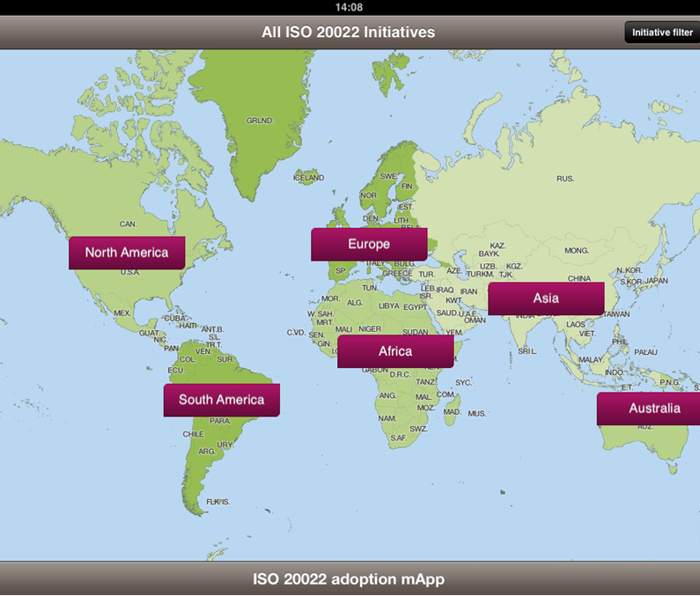

Who is using ISO 20022?
Brought to you by the ISO 20022 Registration Authority
A free IOS tablet app,
(also as PDF and high-level slide presentation) that provides an overview
of initiatives adopting ISO 20022
ISO 20022
Facilitating adoption
and fostering dialogue
> Information provided by
initiative* owners
> Covers all regions &
business segments
> Easy to use, contribute to
and maintain
> 65
initiatives
* Initiatives who plan to adopt the official ISO 20022 messages registered on www.ISO20022.org
Notes:
Not on android (yet)

Slide 12

ISO 20022 adoption in the corporate-to-bank space
SE
NL
BE
FI
DK
DE
RU
CA
IE
UK
SEPA
AT
SK
FR
JP
US
CH
CN
LU
KR
IT
ES
HK
PT
MX
SG
Almost
100 members
(corporates and banks)
defining
common global
implementation
guidelines
AU
ZA
SWIFT
for
Corporates –
Cash
management
Based on
CGI
guidelines
More than
60 banks in 27 countries receiving
payment initiation
messages
Snapshot Jan 2015

Slide 13
ISO 20022 for Cards
From discussion to implementation - EPASorg
CPA, CA
FR
Snapshot Jan 2015

Slide 14
Agenda
ISO 20022 Refresher
Who is using ISO 20022?
ISO 20022 in practice
How to get the best out of two worlds?

Slide 15
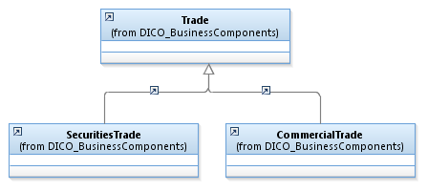
The business model is just a set of stories
And to tell the stories, we use some conventions
A Securities trade is a kind of trade
A Commercial trade is a kind of trade
These types of trades inherit from the elements and the associations of Trade
The relationship between commercial and securities trade versus Trade is “or”:
a trade is a commercial trade or a securities trade

Slide 16
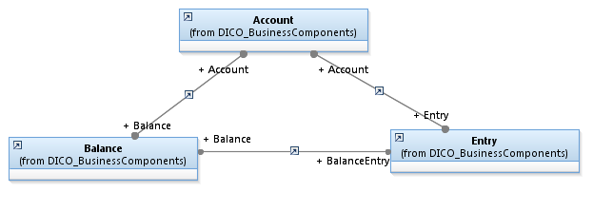
Some more conventions....
Bidirectional relations
Account has a Balance and Balance is part of Account
Entry is part of Balance and Balance has Entries
The relationship between Balance and Entry versus Account is “and”:
an account is associated with a balance and entries.

Slide 17
Business modeling Concepts
Domains and Business Processes
Obligations
Trades
Parties and Roles

Slide 18
Domains / Business Processes
Payments
Credit Transfer
Direct Debit
Payment Initiation
Payment Cards
Bank Account Management
Exceptions and Investigations
Commercial Trade
Invoice Financing
Guarantees
Securities Settlement and Reconciliation
Securities Order
Post Trade Matching
Collateral
Corporate Action
Proxy Voting
Investment Funds
Treasury

Slide 19
Concepts
Domains
Obligations
Trades
Parties and Roles

Slide 20
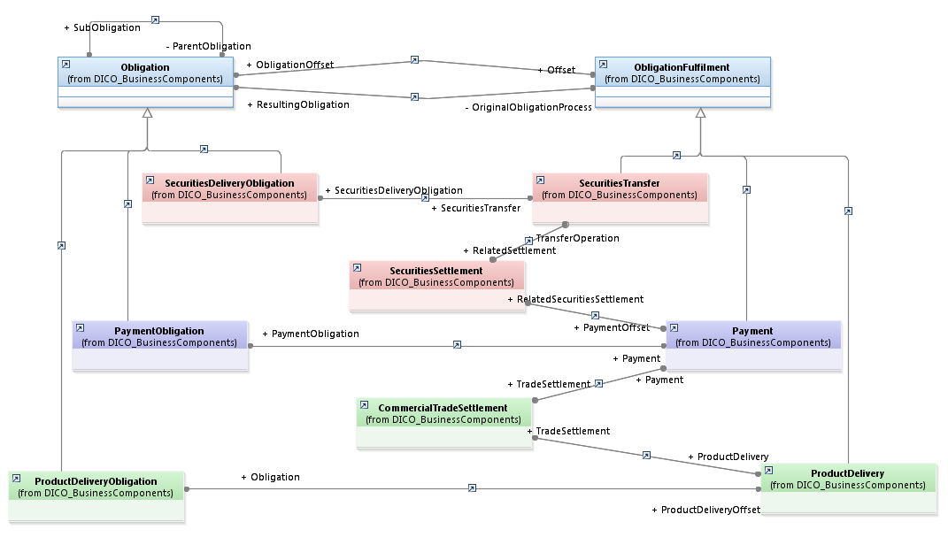
Obligation
An obligation is often created by a trade and its execution, it is offset by an obligation fulfilment. In some cases the fulfilment may create a new obligation (e.g. netting).

Slide 21
Obligation
Obligation for the seller to deliver the securities to the buyer.
Obligation for the debtor to deliver the cash to the creditor..
Obligation for the seller to deliver the goods or services to the buyer.

Slide 22
Obligation Fulfilment

Slide 23
Concepts
Domains
Obligations
Trades
Parties and Roles

Slide 24
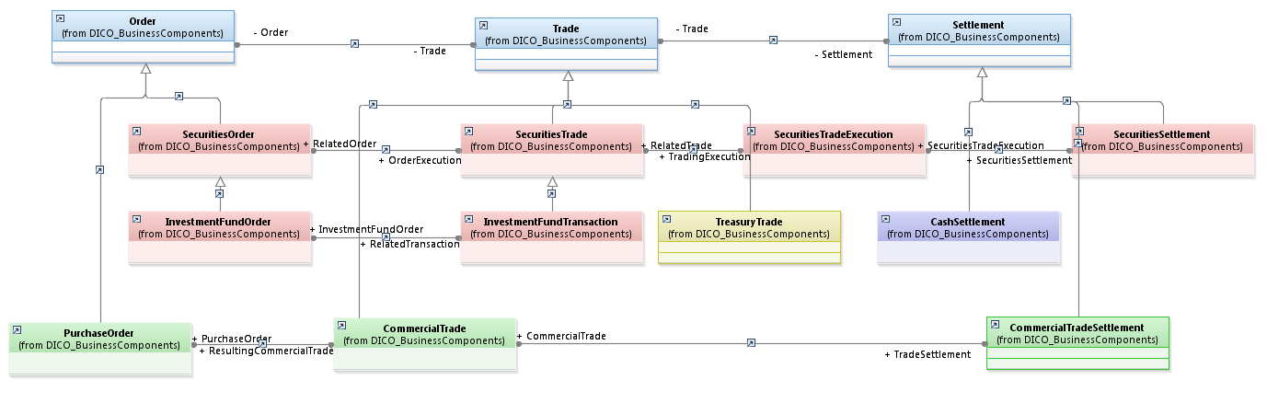
Trade
An Order and a Settlement are part of a Trade. A trade has an order and a settlement.

Slide 25
Trade (Order)
An order can be a purchase order, a securities order or its subtype, an investment fund order (redemption or subscription)

Slide 26
Trade
A trade can be a securities trade and its execution in the market, a treasury trade or a commercial trade. An investment fund transaction is a subset of a securities trade.

Slide 27
Trade (Settlement)
Settlement information can be related to cash, securities or the settlement of a commercial trade.

Slide 28
Trade (Full)

Slide 29
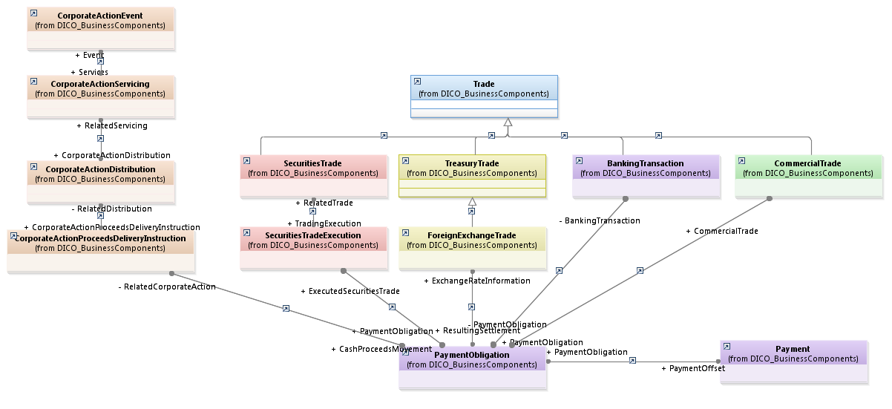
Transactions and Payments
A securities trade may lead to a payment versus securities, an FX trade will be settled by the payment of the currencies, a commercial trade will consist of a payment versus goods, each banking transaction (e.g. mortgage) leads to a payment.
Corporate actions too may create payment obligations.

Slide 30
Concepts
Domains
Obligations
Trades
Parties and Roles

Slide 31
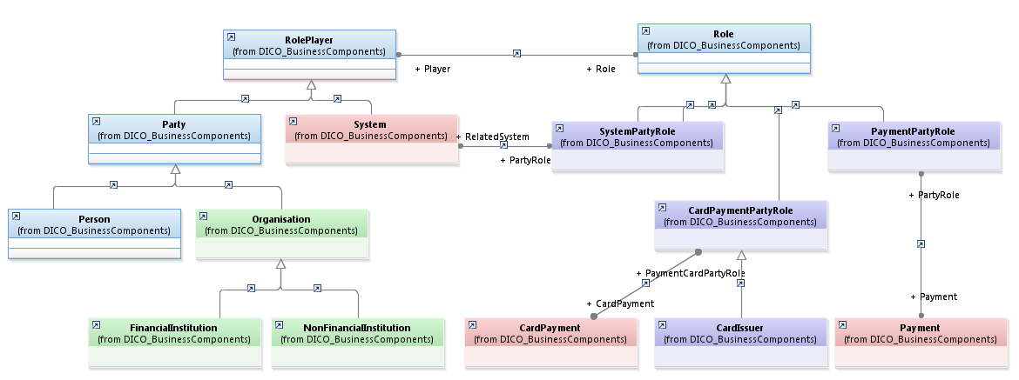
Parties and Roles
Role players are parties or systems. A party is a person or an organisation (financial or not financial).

Slide 32
Parties and Roles
Roles are specified in the context of a business domain. A payment role is related to payments. These roles can be specialised by other roles e.g. card issuer is a subset of card party role.

Slide 33
Parties and Roles

Slide 34
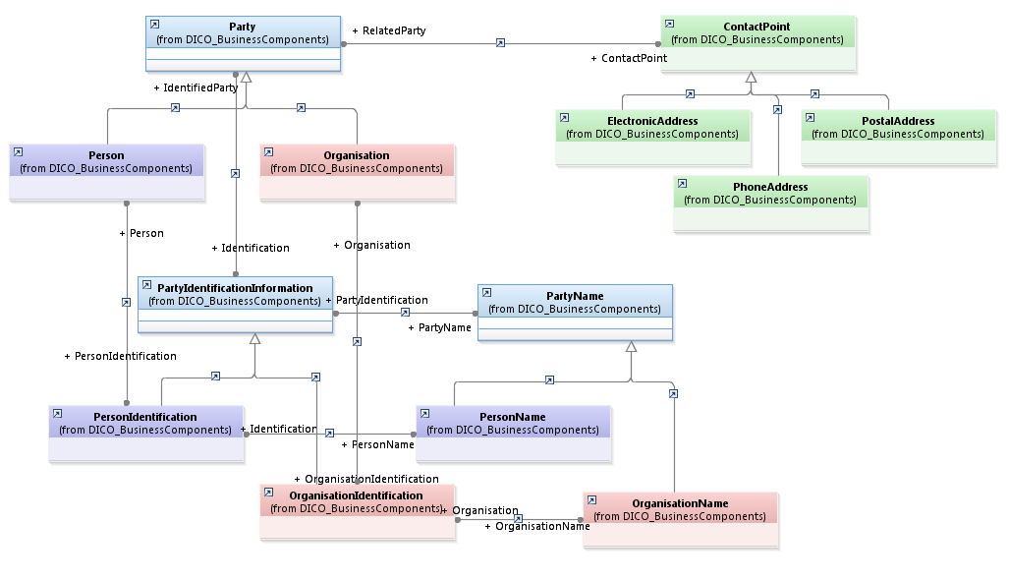
Party Identification
An address identifies a party..

Slide 35
Party Identification
A party is identified by different codes, identifiers, text which may differ per party type.

Slide 36
Party Identification
A name is also used to identify a party.

Slide 37
Party Identification

Slide 38
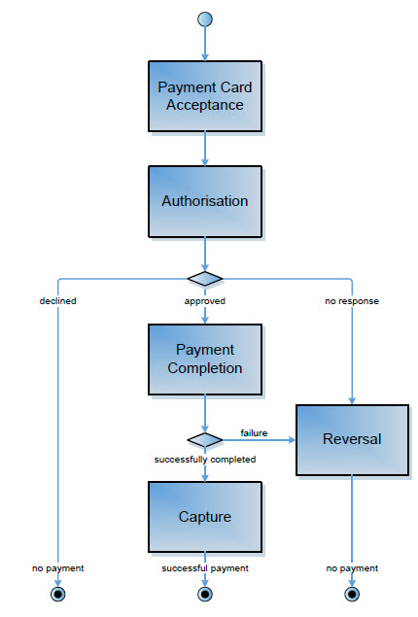
...a payment card business process flow

Slide 39
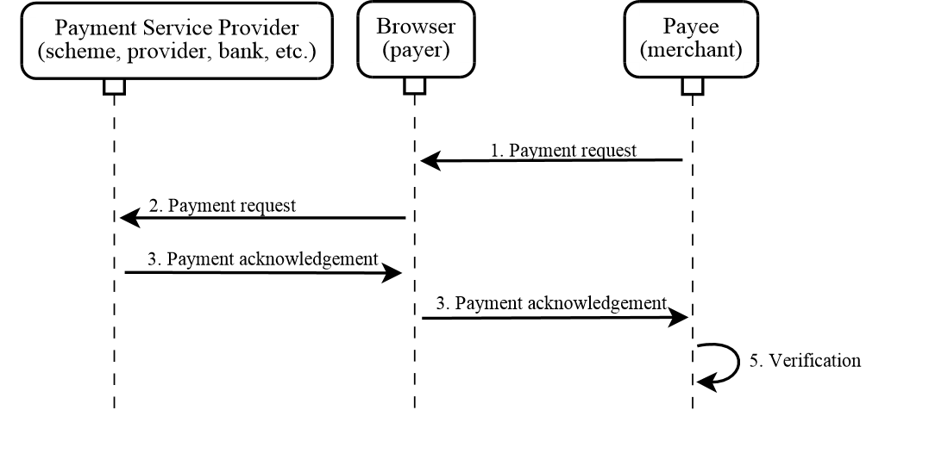
A snippet from the Web Payments API 1.0

Slide 40
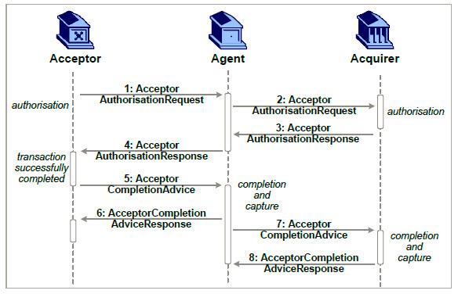
... Card authorisation and completion through an intermediary agent
A typical PSP: provides value-added services such as switching to different acquirers, loyalty processing, aggregation of low value payments, etc.

Slide 41
Defining the content of the flows

Slide 42
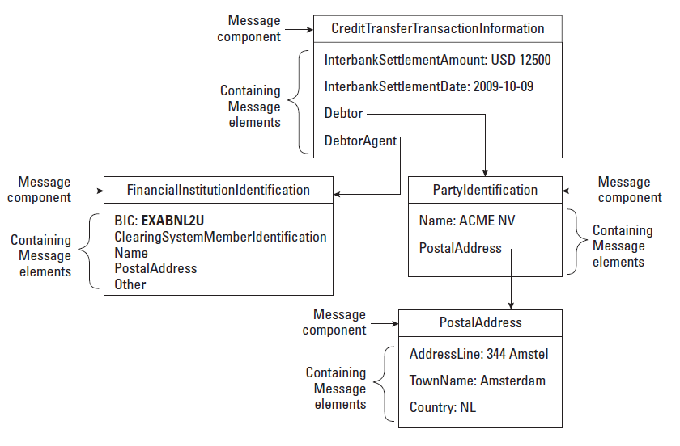
Methodology - Logical Layer
Elements in the Logical Layer refer to the Business layer for their definitions

Slide 43
Giving each flow a syntax jacket

Slide 44
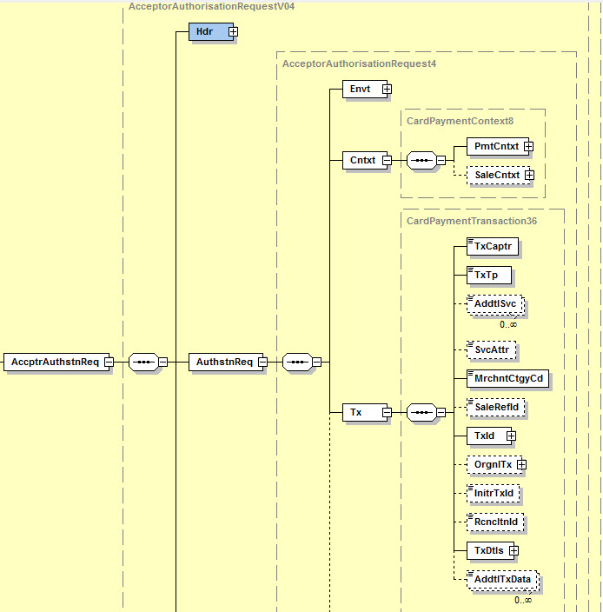
The context of the Card payment transaction
Transaction Information

Slide 45
Agenda
ISO 20022 Refresher
Who is using ISO 20022?
ISO 20022 in practice
How to get the best out of two worlds?

Slide 46
How can we collaborate?
Some thoughts...
The ISO 20022 repository is a pot of gold, waiting to be collected
W3C has a vast technology experience
W3C Payments WG to become the submitting organisation for web payments messages?
The TSG is working on extending the ISO 20022 specification to contain API calls.
    Web Payments IG (or WG?) to liaise with the TSG (Technical Support Group – responsible for the technical side of the ISO 20022 standard)?

Slide 47

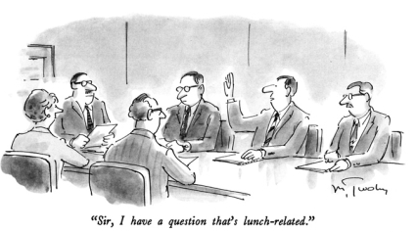

Slide 48
Back-up slides

Slide 49
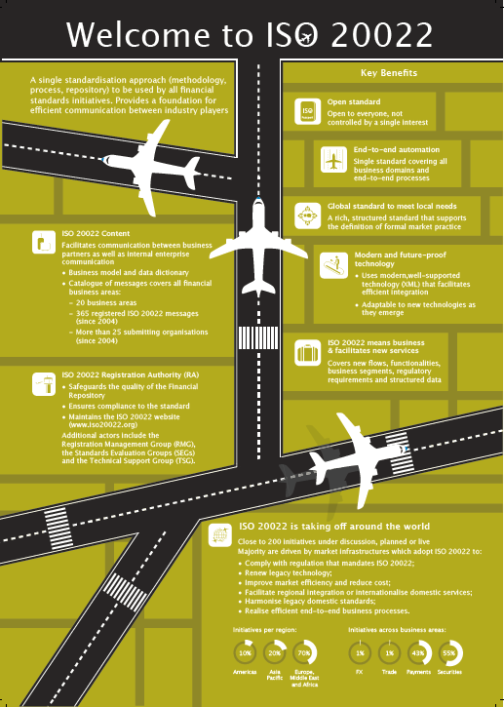

Slide 50
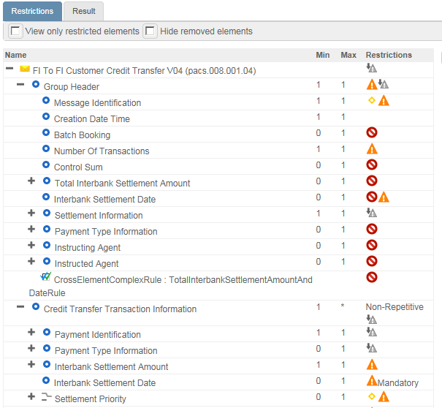

Standards are created globally and used locally: market practice and variants
How to create, share and test
market practice?
Removing optional elements
Make optional elements
mandatory
Limiting the repetitions
Limit options
Restricting data types
Reducing code lists
Based on community needs
MyStandards
Readiness
Portal

Slide 51



ISO 20022 compliance at model level
Repository
ISO 20022 Business models
Dictionary
Catalogue
ISO 20022 message models
Card payments
Payments clearing
& settlement
physical message representation
ISO 20022 ASN.1 syntax
ISO 20022 XML syntax
Notes:
The first edition of ISO 20022 described only one set of rules to transform the message models into a ‘ISO 20022 XML’ syntax. However, in some business areas, the ISO 20022 XML syntax may not be the most efficient. For example, in the cards business domain, there may be a need to use a more ‘compact’ syntax than the ISO 20022 XML syntax. This is for this reason that the last edition of ISO 20022, published in 2013, included ASN.1 as another possible syntax for ISO 20022 messages. To ensure a smooth flow of business information from the card payment message to the payments clearing and settlement messages that will be used to execute the card payment, it is key to use the same business concepts in the two sets of messages. This is achieved by using the ISO 20022 recipe and the central Data Dictionary to model the two message sets. Once the models are approved, it is possible to transform the resulting message models into the desired syntax: in the example above, ASN.1 for the cards messages and XML for the ‘pacs’ messages.

Slide 52


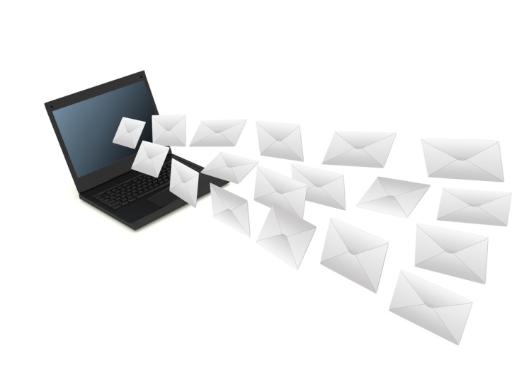

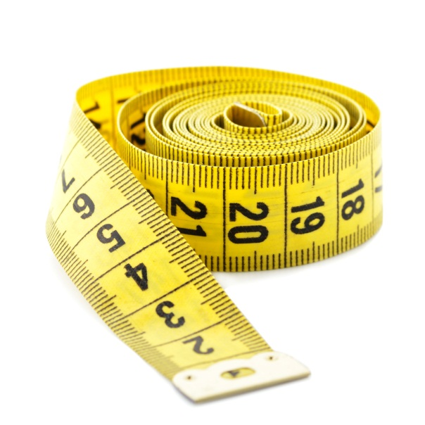


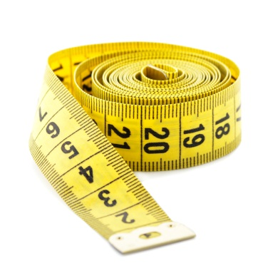
A summary
The power of ISO 20022
The standard is being used!
Re-usable message components, electronic message formats (XML Schema’s), character set
Open, neutral methodology to develop standards
Ease of
integration
Syntax-independent model
Key concepts
Everyone can
participate
Future-proof
Greater
automation
Allows for
interoperability
Rich, structured
data
Data dictionary approach allowing referencing by other standards
Scenario-based standards facilitating
market practice
End-to-end business-centric approach
Notes:
Richness of the data allowing greater end to end automation of information and foundation to support future services (e.g. Remittances information, regulatory reporting…)
Business scenario-based standards where business requirements that need to be met are clearly outlined and defined
Ease of integration in back-office with re-use of components that are well structured across messages
XML syntax is the most prevalent representation of structured information, enabling easy processing
Future-proof because of the syntax-independent model
Ease to use development/maintenance tools
‘Shorter’ & less costly implementation cycles
Inherent advantages: e.g. character set & extensibility
Distribution, discussion, documentation

