Slide 1

0
360Pay
Introduction
360Pay Introduction
Songfeng Li, Qihoo 360
2016-09-23
Notes:
Hello,my name is Songfeng. Next, I will introduce 360Pay briefly. 360Pay is developed by Qihoo 360, mainly used by the subsidiary of Qihoo 360, for example 360Mall, an online store and nicaifu.com, the Internet Finance company.
360Pay doesn’t has big difference to other payment systems from China, except it’s now mainly used interior. I’s also have the bank-level security

Slide 2
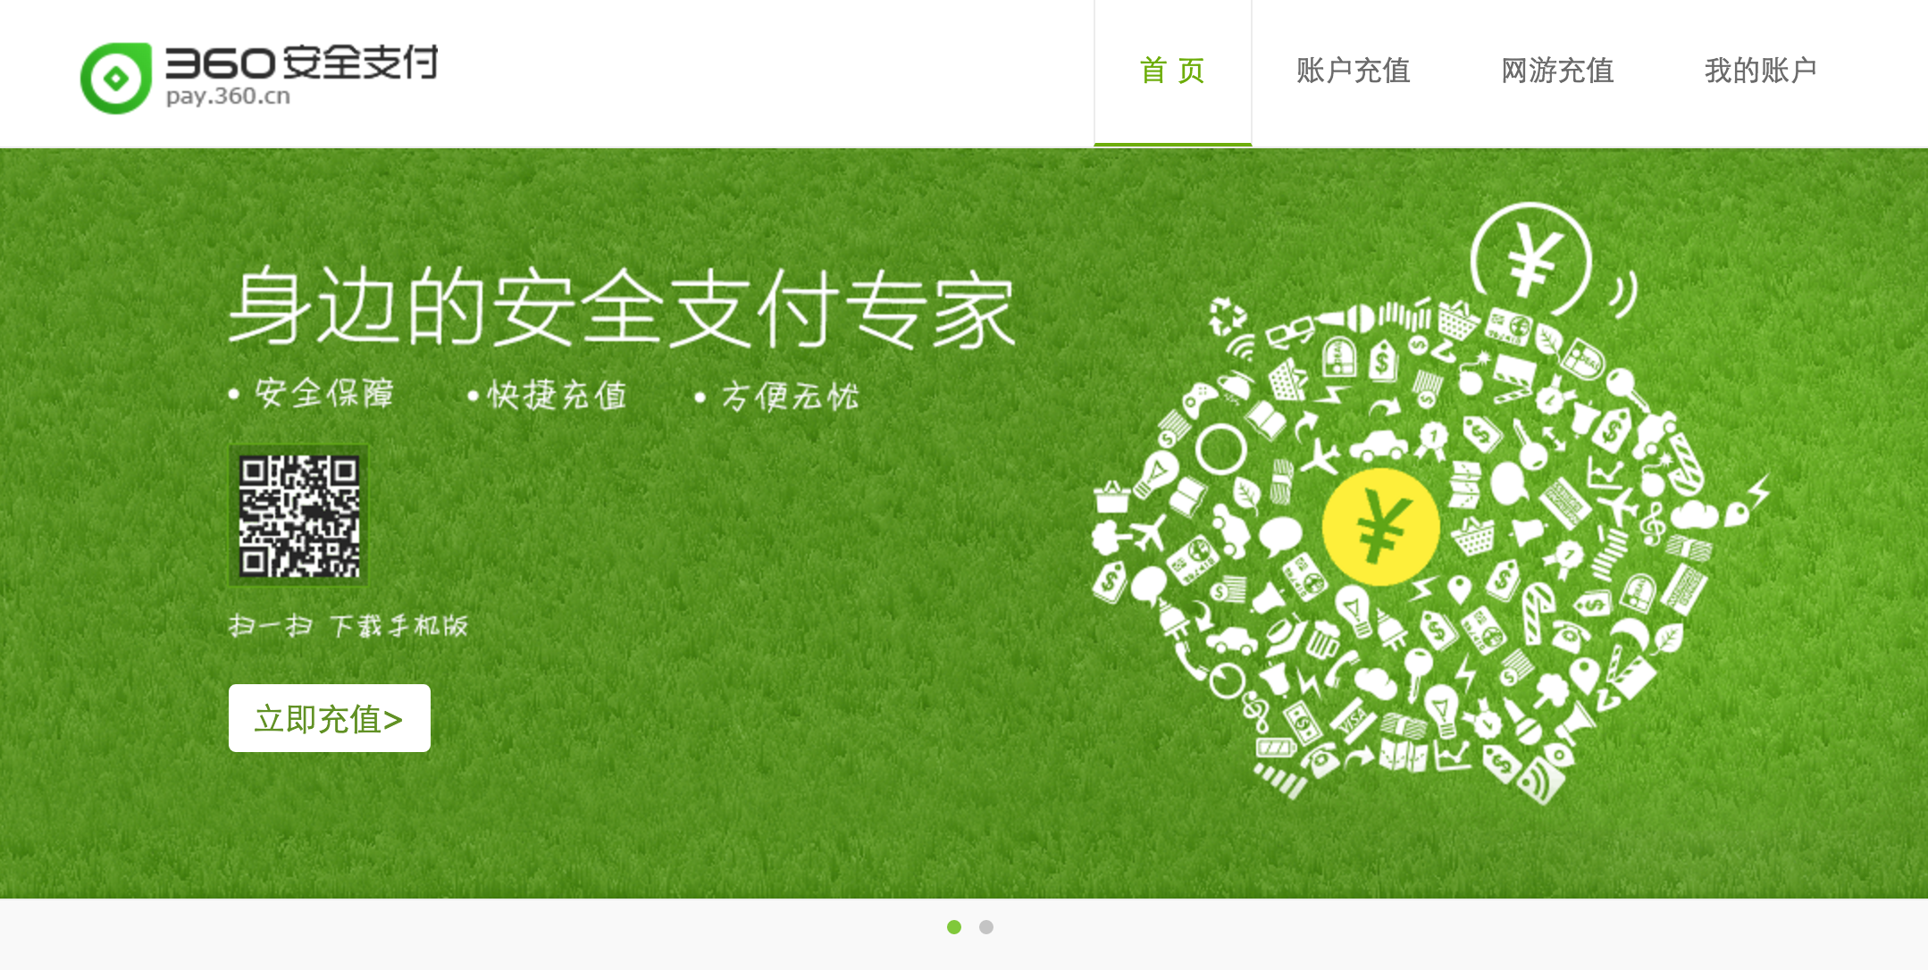
1
360Pay
About
Notes:
Hello,my name is Songfeng. Next, I will introduce 360Pay briefly.

Slide 3
1
360Pay
About
Bank-level
security
Billions $
transaction
Notes:
360Pay is developed by Qihoo 360, it has the bank-level security and billions dollars transaction.

Slide 4
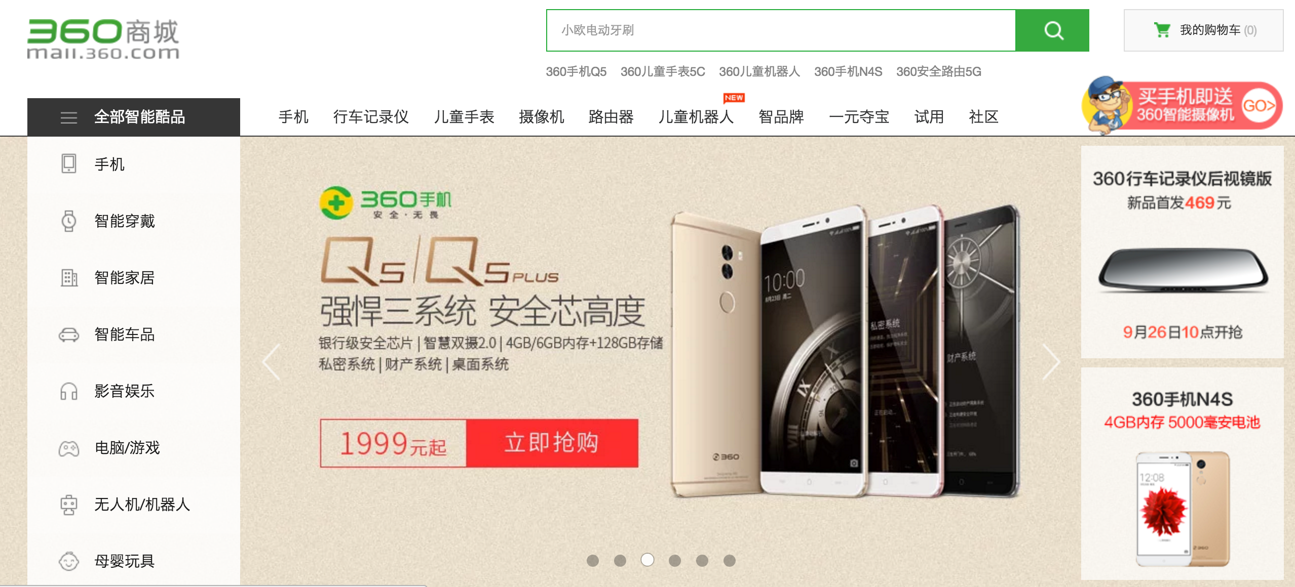
1
360Pay
About
Notes:
Until now, 360Pay mainly used by the subsidiary companies of Qihoo 360, for example 360Mall, the online store of Qihoo 360

Slide 5
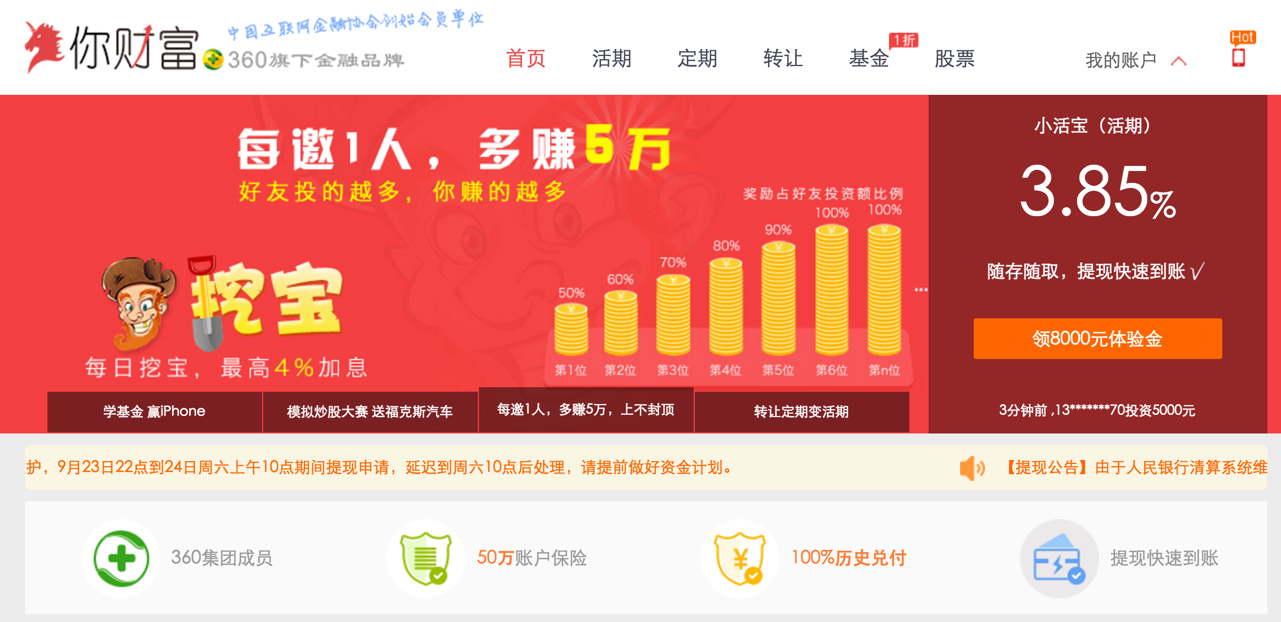
1
360Pay
About
Notes:
and the nicaifu.com,（ You Fortune['fɔrtʃən]） the Internet Finance company of Qihoo 360.
and others sub-companies.

Slide 6
2
360Pay
Payment flow
Basic payment flow
Quick payment flow
Notes:
360Pay doesn’t has big differences to other payment systems from China, except it’s now mainly used by interior ([ɪn'tɪrɪɚ]).
So I will introduce the two main payment flow of it. First is Basic Payement Flow

Slide 7

2
360Pay
Basic payment flow
User Browser
Merchant Server
360Pay Server
Merchant constructs the request with the required arguments and signed the HTTP query string with the secret-key provided by 360Pay
360Pay received the payment request, and valid the merchant with its signature. If success then go to the online bank page or third-party payment interface to finish the payment
After payment, go to the return_url provided by the merchant
User submit
Place order
Submit payment request arguments to 360Pay
Return payment success page return_url
Back-end notification
Confirm received
Confirm payment success, and the items can be shipped
Notes:
Merchant constructs the request with the required arguments and signed the HTTP query string with the secret-key provided by 360Pay
360Pay received the payment request, and valid the merchant with its signature. If success then go to the online bank’s page or third-party payment interface to finish the payment
After payment, go to the return_url provided by the merchant
That is the basic payment flow.

Slide 8
3
360Pay
Quick payment flow
Merchant Client
Merchant Server
360Pay Server
Merchant query the binding information with the user ID
If found binding, show the bound card so user can select it; if not found, show the info-collection page, ask the user input and confirm payment
Merchant submits payment request based on the selection or the input from users
360Pay return the payment reslut
Place order, select Quick Payment
Sent bind query request to 360Pay
Show info-collection page base on the bind result
Return the bind result
User input and confirm payment
Sent payment request
Return the acceptance result
Sent Asyc-notification to
The notify_url provided by
merchant
Confirm received notification
Notes:
Merchant query the binding information with the user ID
If found binding, show the bound card so user can select it; if not found, show the info-collection page, ask the user input and confirm payment
Merchant submits payment request based on the selection or the input from users
360Pay return the payment reslut
Ok, that is it. Thank you!

Slide 9
E
360Pay
Thanks
Thanks
Notes:
Hello,my name is Songfeng. Next, I will introduce 360Pay briefly. 360Pay is developed by Qihoo 360, mainly used by the subsidiary of Qihoo 360, for example 360Mall, an online store and nicaifu.com, the Internet Finance company.
360Pay doesn’t has big difference to other payment systems from China, except it’s now mainly used interior. I’s also have the bank-level security

