Slide 1
5G – Enabling technology for web integration?
… or not? Is this déjà vu all over again?
Dan Warren, Head of 5G Research, Samsung

Slide 2
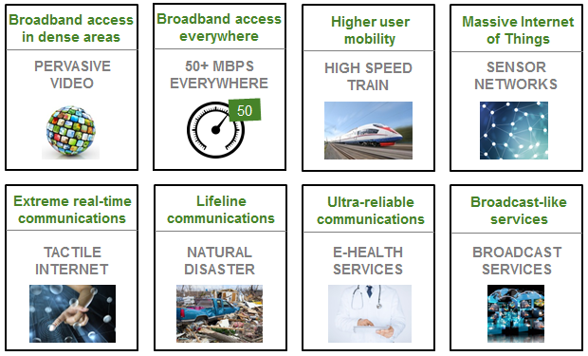
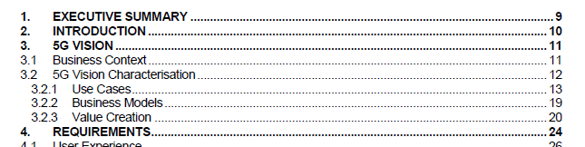
Starting point - ‘5G is different’
Service, application and business case-led definition
Source – NGMN White Paper, 2015 https://www.ngmn.org/de/5g-white-paper/5g-white-paper.html
5G Vision defined around Business Context, and Characterisation based on Use Cases, Business Models and Value Creation

Slide 3
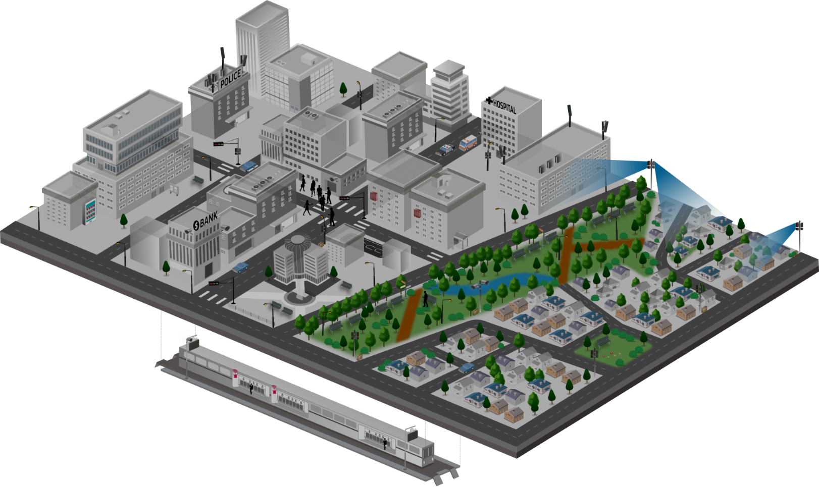












5G Service Scenarios
Key Scenarios to be Addressed throughout the Multiple Stages of 5G Development
1
Mission Critical Service
4
Fixed Broadband
· Full reliability & high availability
· Real-time responsiveness
· On-the-fly coverage scalability
for disaster situations
· Next-generation broadband
· Multi-Gbps peak throughputs
· Alternative to costly fibre
· New VAS possibilities for
fresh revenue generation
Requirements
Ambulance
10x bandwidth per connection
Low-ms latency
Five 9’s reliability
100% coverage
>10x connections
50Mbps per connection everywhere
1000x bandwidth/area
10 year battery life
Reduction in TCO
Autonomous driving
Vending machine
CCTV
CCTV
2
Massive IoT
3
Mobile Broadband
· Connectivity for a new wave of device types
· High density deployments
· Networks-as-a-Service to meet
each service provider’s needs
· Robust QoE / QoS management
· New revenue opportunities
CCTV
· Multi-Gbps peak throughputs
· Universal gigabit connectivity
· Unparalleled mobility support
· New service / application enablement
· Advanced big data analytics

Slide 4
Different contexts of the same environment
Requirements
Applications
Customer segments
MNO biz model
10x bandwidth per connection
Low-ms latency
Five 9’s reliability
100% coverage
>10x connections
50Mbps per connection everywhere
1000x bandwidth/area
10 year battery life
Reduction in TCO
Enhanced Mobile BB
Connected vehicles
AR/VR
S-UHD/3D Video
Haptics/Sensing
Massive IoT
Remote machine control
Mission critical services
Fixed-wireless access
…
Consumer
Auto industry
Health
Industry 4.0
Agriculture
Smart City/Public sector
Smart building
Utilities
Education
Transport
…
B2C
B2B
B2B2C

Slide 5
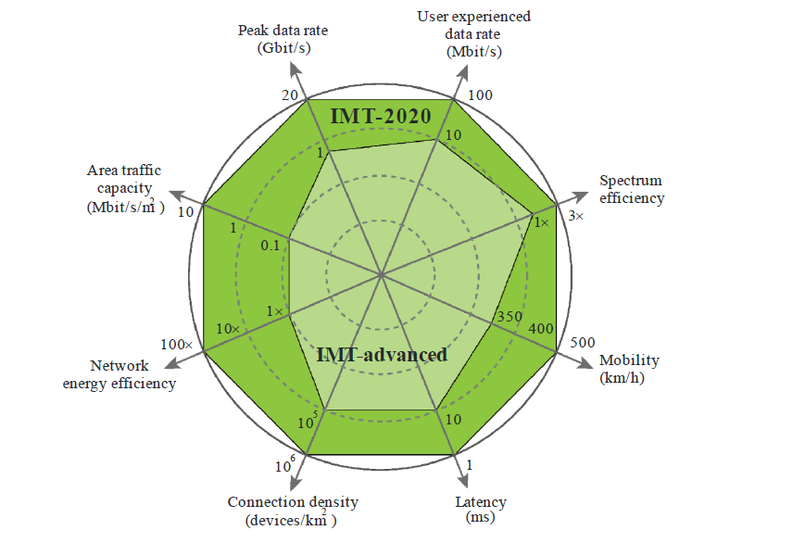
Faux requirements – Five 9’s and 100%
What’s Missing?
ITU-R has no requirement for 100% coverage* or for 99.999% availability
So why does everyone keep talking about them?
Because they are included in everyone’s marketing, but no one knows why they were put there.
NGMN’s white paper mentions ‘availability close to 100%’.
*ITU-R M.2083 does state ‘Achievable data rate that is available ubiquitously across the coverage area’, but in a foot note clarifies that ‘The term “ubiquitous” is related to the considered coverage area and is not intended to relate to an entire region or country’
… or in other words, when they say ubiquitous, they don’t actually mean ubiquitous
Source – ITU-R M.2083 ‘IMT Vision – Framework and overall objectives of the future development of IMT for 2020 and beyond

Slide 6
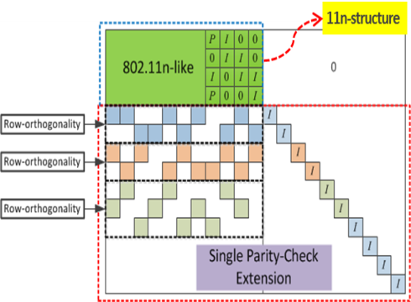
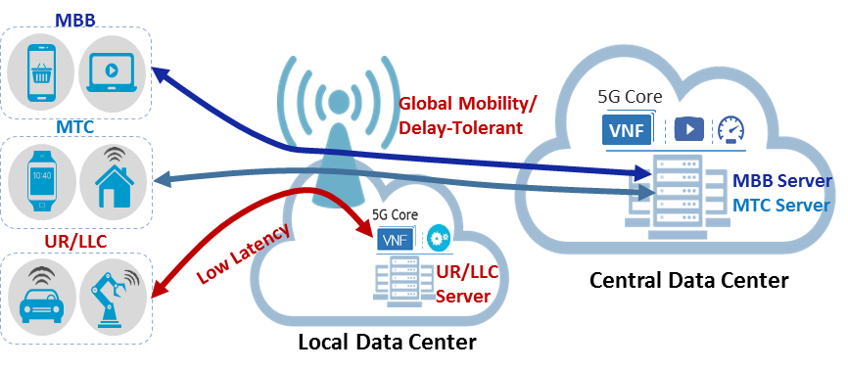
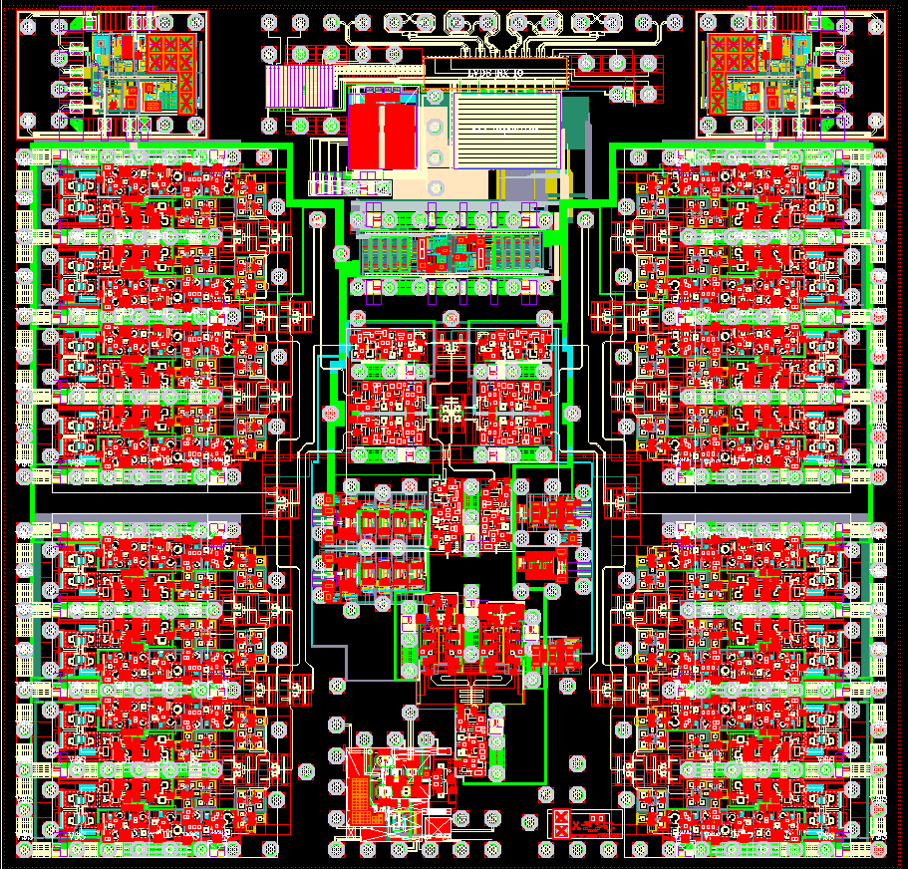

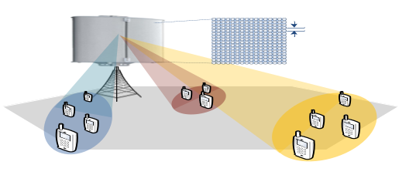






5G Service Enablers – meeting requirements
mmWave System/RFIC/Ant.
New Channel Coding
Network Slicing
700 MHz
3 GHz
18
27
30 GHz
Legacy Bands
New Bands
mmWave
RFIC
Wide
Coverage
Antenna
LDPC (Low-Density Parity-Check )
< 6 GHz Massive MIMO
Massive Connectivity (IoT)
Low Latency NW
Half
-Wavelength
Grant-based
Multiple Access
Grant-Free
Multiple Access
① Radio
Information
② TCP Rate
Control
eNB
3~4 Step
1 Step
eNB
UE
UE
Data
Mobile
BS
Server

Slide 7


New for 5G – RAN architecture extensions
New Air Interface
CP-OFDM – to introduce flexibility in OFDM and mitigate Inter Symbol Interference
Massive MIMO – large numbers of bearers to increase bandwidth in sub-6GHz bands
mmWave – provides access to broad frequency bands for higher bandwidths
Beam Forming – extends range/cell size for mmWave bands
Shortened TTI – reduces latency
Flexibility in band sizing – allows previously unavailable bands to be used
UE
Other RAN innovations
CoMP – UE attached to multiple cells to provide greater reliability
Small cell support – greater indoor coverage, increased cell density, self-backhauling
5G-NR in unlicensed bands – extension of mobile ecosystem
Session management split from mobility management – enabler for RAN slicing
D2D, V2X – devices connecting directly, with no network

Slide 8

(not so) 5G – topology flexibility
MEC
(RAN, CN)
MEC
(RAN, CN)
Core,
Policy VNF
Transport VNF
UE
C-RAN
(V)PDG
MEC
(RAN, CN)
MEC
(RAN, CN)
MEC
(RAN, CN)
‘Softwarisation’ of the network
C-RAN – removal of functionality from cell sites to consolidation point in the network
NFV and SDN – enabling flexibility in where functions are deployed and scaled
MEC – pushing Core Network functions and content ingress to cell sites
CP/UP split – decoupling of user plane traffic from control plane functions

Slide 9
CP-OFDM
Massive-MIMO
Beam Forming
Meeting the goals
Shortened TTI
Flexible Band Sizing
CoMP
Helps
Hinders
Small Cell
5G-NR in Unlicensed
Session/Mobility split
10x bandwidth per connection
C-RAN
Low-ms latency
NFV/SDN
Five 9’s reliability
MEC
Significant network investment required
Achieving these requirements is dependent upon Operators deploying cells and resiliency methods to provide extended coverage and network
capacity, as well as upgrading backhaul
100% coverage
>10x connections
50Mbps /connection everywhere
1000x bandwidth/area
10 year battery life
Reduction in TCO
Enablers for
network slicing

Slide 10
Pain points for commercial slicing
Orchestration Layer
Inter-orchestration system interface
RAN Orchestration
CN Orchestration
Transport Orchestration
Orchestration
(Network Splicing)
Enterprise
Customer (or SI)
CN, Policy
VNF
Transport VNF
CN, Policy
VNF
Orchestration
MEC
(RAN, CN)
MEC
(RAN, CN)
CN, Policy
VNF
Enterprise
Customer
UE
CN, Policy
VNF
Orchestration
Enterprise
Customer
C-RAN
(V)UPF
Data
Centre
Apps
VNF
vCPE
MEC
(RAN, CN)
MEC
(RAN, CN)
Data
Centre
Apps
MEC
(RAN, CN)
Data
Centre
Apps
NB-IoT, LTE-M slice
2G, 3G, 4G Slice
Wi-Fi Slice
Fixed Line Slice
Potentially multiple other network slices per network customer
One (or more) 5G slice per enterprise customer

Slide 11






An example of Secondary implications
V2N2X
V2N2N2X
V2N2multi-N2X
V2vN2hN2multi-N2X??
MEC
MEC
MEC
Barcelona
Very localised interconnect
Completely new Roaming model
Technical and commercial challenges

Slide 12



5G – Standalone vs Non-Standalone
Today – 4G Access
Device attaches to LTE/4G radio and Evolved Packet Core (EPC)
Early 5G – Non-Standalone
Device attaches to 5G-NR, which routes either via 4G Base Station to EPC, or direct to EPC
5G Standalone
Device attaches to 5G-NR and 5G Core Network.
EPC
4G
5G-CN
5G

Slide 13
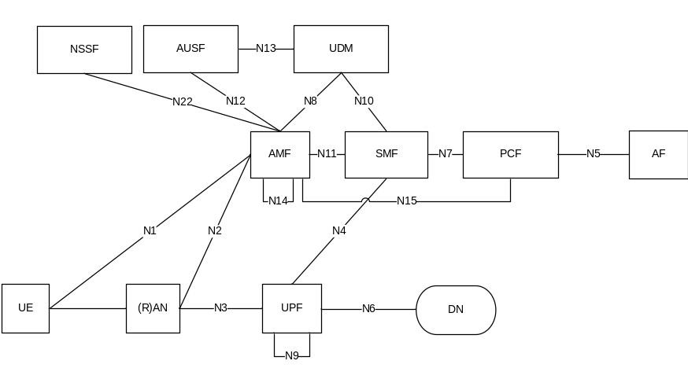
5G CN Architecture
Traditionally 3GPP has documented the architecture of the system (in Stage 2 Working Groups) using Reference Points and Network Functions
In principle there is one Reference Point between each pair of Network Functions
The functionality of each Reference Point is then defined in terms of the messages exchanged between the Network Functions, as shown in call flows in the Technical Specifications
The Stage 3 Working Groups take these call flows and translate them into protocols
Different protocols can, and often are, used for different Reference Points
Here is the 5G system architecture depicted in this Reference Point style (from TS 23.501)

Slide 14
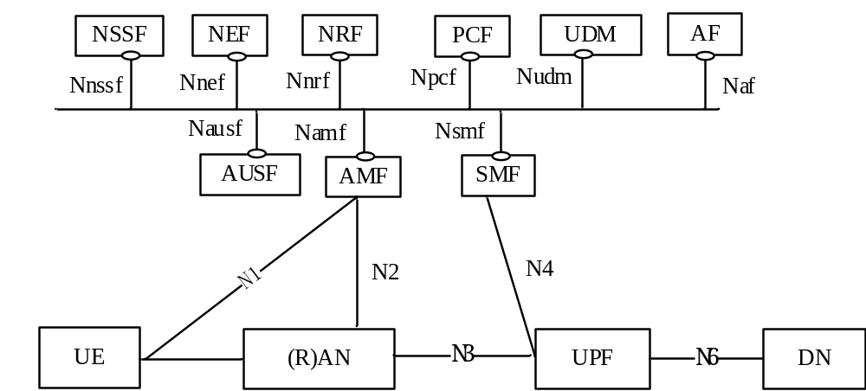
CN redefined as Service-Based Architecture (SBA)
Here is the 5G system architecture depicted in the SBA style (from TS 23.501)
Note that the User Plane functions, and their direct interactions with the Control Plane, are still depicted as Reference Points
However, all of the other Control Plane functions are connected by http2-based service-based interfaces
In principle any service-based interface exposed by a Network Function can be used (consumed) by any other Network Function
Authentication Server Function (AUSF)
Access and Mobility Management Function (AMF)
Session Management Function (SMF)
Network Slice Selection Function (NSSF)
Network Exposure Function (NEF)
NF Repository Function (NRF)
Policy Control Function (PCF)
Unified Data Management (UDM)
Application Function (AF)
Unified Data Repository (UDR)
Unstructured Data Storage Function (UDSF)
5G-Equipment Identity Register (5G-EIR)
Security Edge Protection Proxy (SEPP)
Network Data Analytics Function (NWDAF)
User Plane Function (UPF)
Data Network (DN), e.g. operator services, Internet access or 3rd party services
User Equipment (UE)
(Radio) Access Network ((R)AN)
SBA entities
User Plane entities

Slide 15
Functions, Services, Operations
Each entity in the architecture is (still) called a Network Function
For those entities that are part of the Service Based Architecture
  Each of the interfaces to the Network Functions is a Service Based Interface (eg Nsmf)
  Each Network Function supports one or more Network Function Services exposed via its Service Based Interface
  Each Network Function Service supports one or more Operations
Operations can be invoked by other entities (Consumers)
Consumer
SMF
Request
Create
Nsfm_PDUSession
Response
Update
Release
Nsmf_EventExposure
Operation
Network Function Service
Network Function

Slide 16

An AF with an http2 interface
The Application Function (AF) can be a mutually authenticated third party.
  Could be a specific 3rd party with a direct http2 interface or a interworking gateway exposing alternative API’s to external applications.
Enables applications to directly control Policy (reserve network resource, enforce SLAs), create network Slices, learn device capabilities and adapt service accordingly, invoke other VNF’s within the network…
Can also subscribe to events and have direct understanding of how the network behaves in relation to the service delivered.
Because the SBA is made up of VNFs, the AF could be deployed on a MEC server, in a network Cloud, on dedicated hardware. It could be dynamically brought into the network, or a specific network slice, and then removed when no longer in use.

Slide 17







The de ja vu bit
Parlay-X
OSA/Parlay

Slide 18
















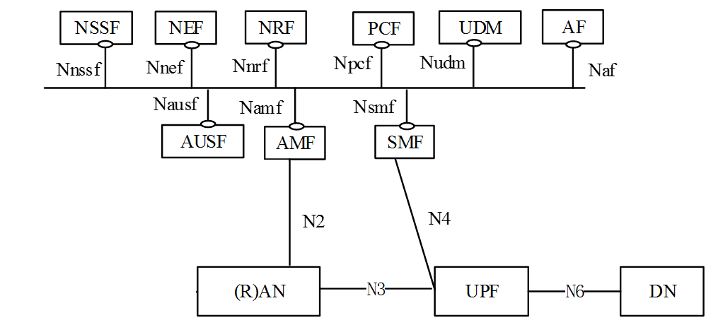




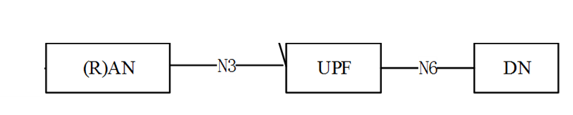










So where does that take us?
Devices
App, Dev, Web communities
APIs
API(s)
Orchestration
MEC
Core

Slide 19
Conclusions – This… but that…
SBA, and the adoption of http2 is an opportunity for Web, App, Dev communities to access network capabilities
Not all networks will be 5G-SA day 1 (or Day N+1), so there is network-specific perspective to what will be available when and where
3GPP are in the process of defining the interfaces in the SBA architecture so there is an opportunity to work with the telecoms ecosystem to get this right
3GPP takes a looooong time, and adoption may take even longer – will web community wait? (You haven’t in the past, particularly when device APIs get the job done)
URLLC and Massive IoT are the target use cases for 5G
eMBB is where initial launches will be targeted.
B2B, B2B2C business models drive 5G business case
No one actually knows what the business case is yet, and B2B, B2B2C come with different expectations from the customer around SLA, KPI and contractual penalties, liability
Set aside the radio – an SBA 5G Core network, with softwarisation, virtualisation, orchestration, MEC and slicing is going to take operators a while to get their heads around.

Slide 20

Consequences if we take all as read…
1ms latency for AR, VR, remote surgery is pointless without a video codec that runs significantly faster than 1000 frames per second.
TCP/IP is not fit for purpose. Packet loss handling will break a lot of 5G use cases
…and neither is GTP. Internet of Things needs ‘Internet to the Thing’ without a proprietary connectivity network in the way.
Telco networks have had to wait for common hardware platform performance to reach current performance and availability requirements before NFV/SDN could happen. 5G performance and availability requirements are an order of magnitude harder and pushing the platform down into a more remote part of the network…
‘Driverless’ autonomous cars are great, as long as they are ALL autonomous. There is a massive backward compatibility issue when some cars are driverless and others aren’t.
Existing Roaming model won’t cut it… but we have been trying to change Roaming for years. It is not technology that stops it changing.

Slide 21
dan.warren@samsung.com
@tmgb

