Slide 1

元素优化：弹幕标准化计划与提案
Better elements:
standardization Plan and Proposal
for Bullet Curtain
Notes:
This new experience blurs the line between content and comments
Generation Y seems to be more enthusastic about bullet curtain than others, perhaps because bullet curtain combines two of Generation Y’s favorite technology based activities: texting and watching online videos. They use mobile phones heavily and favor multitasking. By natural, it’s hard for them to watch a video for two hours without speaking out something in the social network.

Slide 2
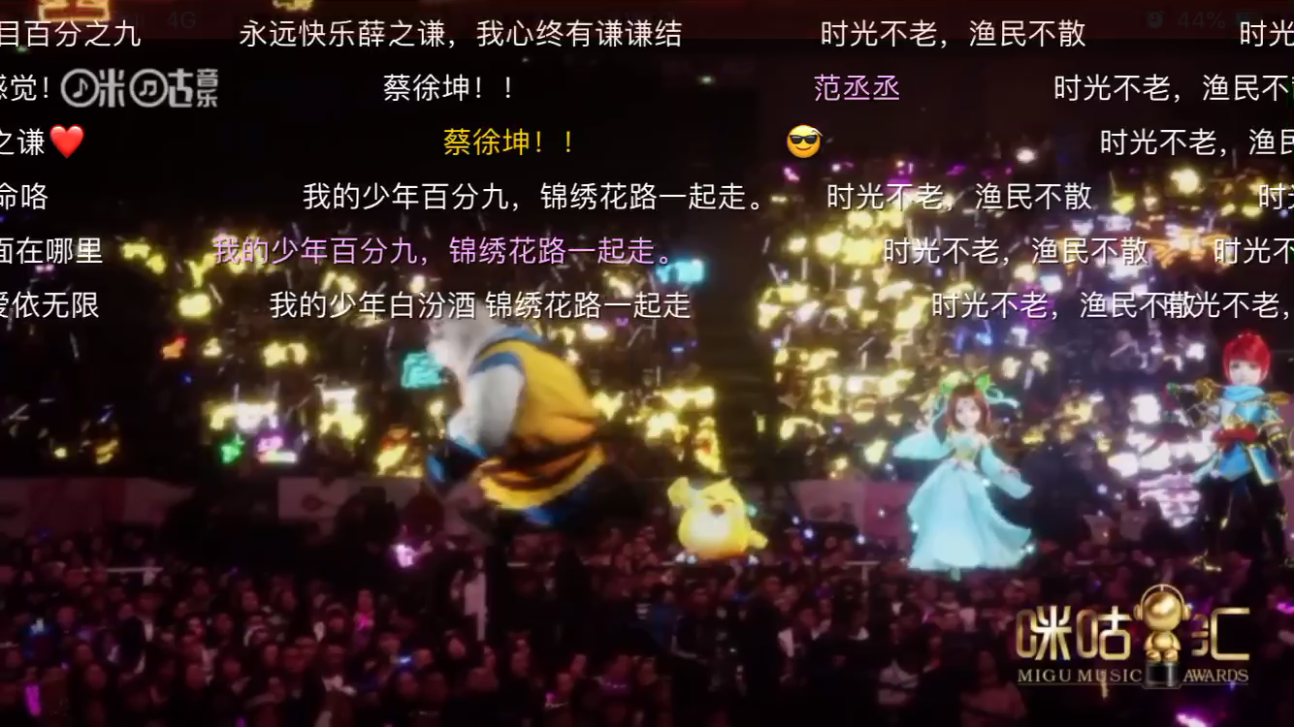
Bullet Curtain - Definition
弹幕 – 定义
弹幕（barrage），中文流行词语，指的是在网络上观看视频时弹出的评论性字幕。类似小说中行间彰显的夹批，视频中屏间飘过的评点叫做弹幕，原意指用大量或少量火炮提供密集炮击。而弹幕，顾名思义是指子弹多而形成的幕布，大量吐槽评论从屏幕飘过时效果看上去像是飞行射击游戏里的弹幕。
Bullet subtitle/bullet screen/danmaku subtitles/barrage refers to the comment subtitles that pop up on the screen when the user watches the video on the network.
Notes:
视频剪辑来自于数月前的咪咕汇中国移动2019音乐盛典。使用了增强现实技术和弹幕技术的视频直播。当晚,在线直播观看人次超1.8亿(a hundred and eighty M),人数达7000万(seventy M),直播互动量超1300万(thirteen M bullet curtain users)。

Slide 3
Bullet Curtain - Scenarios
弹幕 – 场景
同组类型人的兴趣爱好
See reviews of group users: Users can see comments from a group of users, with similar interests in a same video.
实时的交互
Real-time interaction: users can interact and comment with other users.
深深的参与感
Engagement: Viewing the comments as part of the video viewing experience or entertainment.
新一代年轻用户：喜欢一边看视频一边刷微信。
Generation Y: Favor multitasking - texting and watching video.
刷社会存在感
Social Presence: *Studies show that online-based interactions can facilitate social presence.
* Dunlap “Tweeting the Night Away: Using Twitter to Enhance Social Presence” Journal of Information Systems, 2009
* McIssac “The Relationship of Social Presence and Interaction in Online Classes” The American Journal of Distance Education, 2002
Notes:
This new experience blurs the line between content and comments
Generation Y seems to be more enthusastic about bullet curtain than others, perhaps because bullet curtain combines two of Generation Y’s favorite technology based activities: texting and watching online videos. They use mobile phones heavily and favor multitasking. By natural, it’s hard for them to watch a video for two hours without speaking out something in the social network.

Slide 4
Bullet Curtain – Situations
弹幕 – 当前方式和困难
从远程服务器抓取评论的JSON信息，然后通过DOM或者Canvas绘制并层叠在视频上。
The JSON information of the comments is grabbed from the remote server,
then drawn and overlapped on the video through DOM or Canvas.
需要计算弹幕的位置，考虑弹幕与视频的同步，弹幕的速度与动画，
以及不同字号的弹幕文字要避免碰撞。如果视频画面存在人物，需要避免弹幕和人物碰撞（AI相关）
It is necessary to calculate the position of the screen, consider the synchronization
between the screen and the video, the speed and animation of the screen,
and avoid collision of different titles of the screen. If there are characters in the video,
it is necessary to avoid collision between bullet curtain and characters.

Slide 5
Bullet Curtain – Why Standardization？
弹幕 – 为什么要标准化？
弹幕在亚洲地区需求普遍
Demand for bullet curtain is more common in Asia
提升观影体验
Improve user experience when watching videos
降低开发难度
Reduce the difficulty of development, make life easier
统一弹幕数据结构，方便后期扩展高级功能
Unifying the data structure of bullet curtain, expand more advanced functions in the future

Slide 6
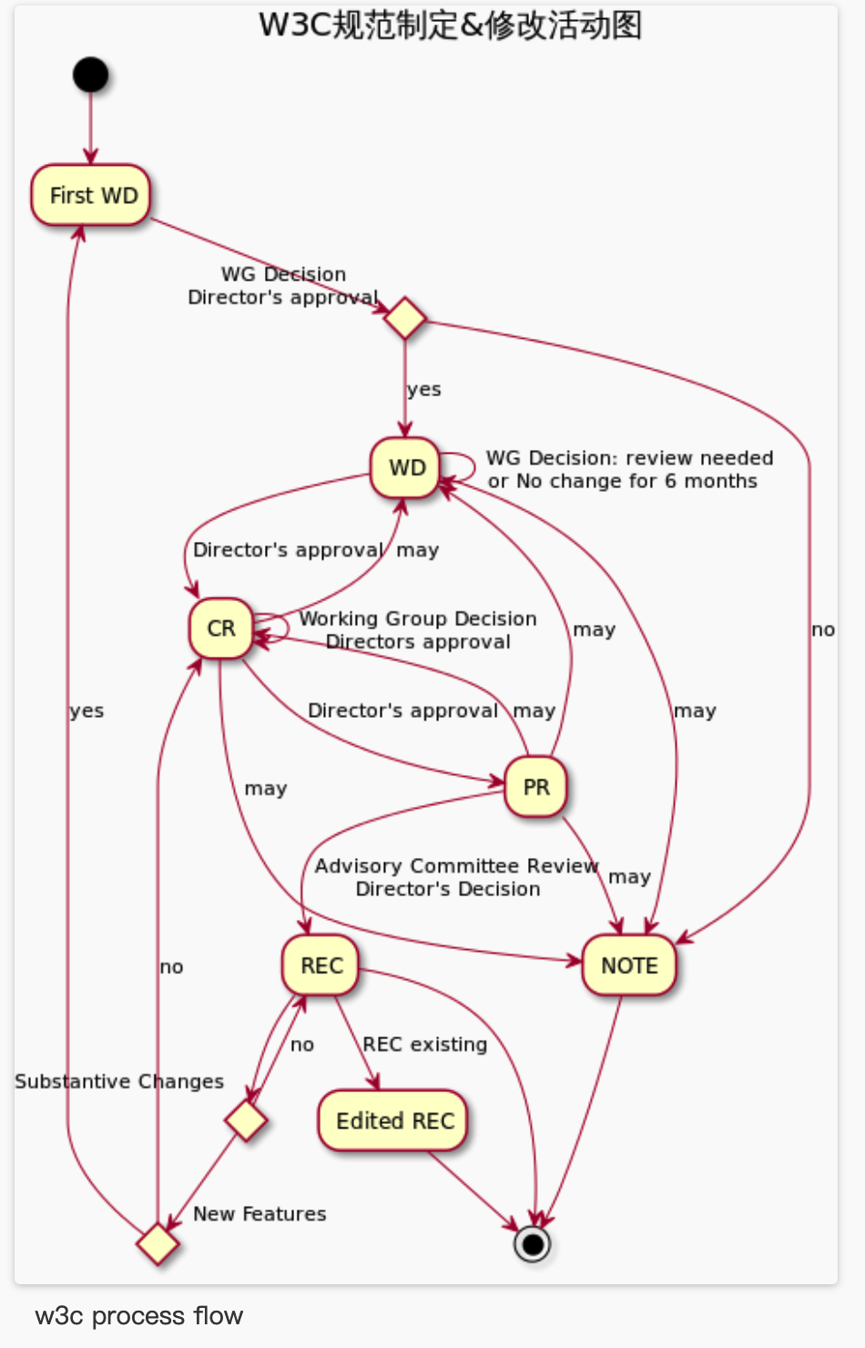
Bullet Curtain – How to Standardize？
弹幕 – 该怎么标准化？
搜集整理弹幕各种使用场景，并精确描述
Collect user cases and scenarios, and describe them clearly
中文兴趣组编弹幕标准Notes
Writings IG Notes for bullet curtain
创建 TF 工作组
Setting Up Task Force
编写弹幕技术细节以及 API文档
Writing explainer notes for bullet curtain, describing API and technical details
向 WICG社区组提交 topic，邀请浏览器厂商进行讨论
Open topics in WICG
Notes:
Web xhr explainer https://github.com/immersive-web/webxr/blob/master/explainer.md
Interactionn Observer explainer https://github.com/w3c/IntersectionObserver/blob/master/explainer.md

Slide 7
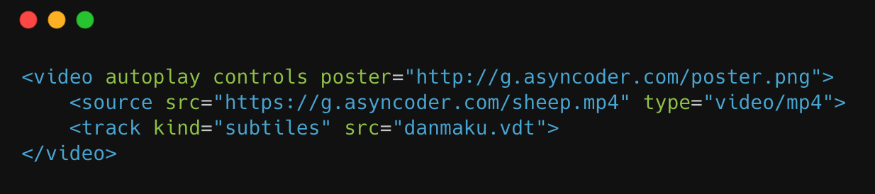
Bullet Curtain – Suggestion
弹幕 – 建议
制定弹幕的标准格式，比如弹幕包含text（文本），color（颜色），style（样式），duration（显示时长）
Develop standard formats for bullet curtain, such as text, color, style, duration and time offset.
以及timeoffset（时间偏移量，用于在指定时间显示文本）
增加新的文件格式（vdt, Video Danmaku Track），vdt的数据格式可以参考上面的说明
Add new file formats (vdt, Video Danmaku Track). The data format of VDT can refer to the instructions above.
通过Video下的track标签引入，Video根据vdt的内容进行自动绘制弹幕。
Introduced through the track tag under Video, Video automatically draws the bullet curtain according to the content of vdt.
Notes:
TTML2 supports animation and can control the display and animation of the bullet curtain, but text collision or overlap cannot be detected. TTML is mainly used for video subtitles, and the content of subtitles is based on XML description. There is a lot of text generated in real-time for the bullet curtain. We try to find a lightweight way rather than to use XML.
Wmt（video mapping track）也是基于 video 进行引入

Slide 8
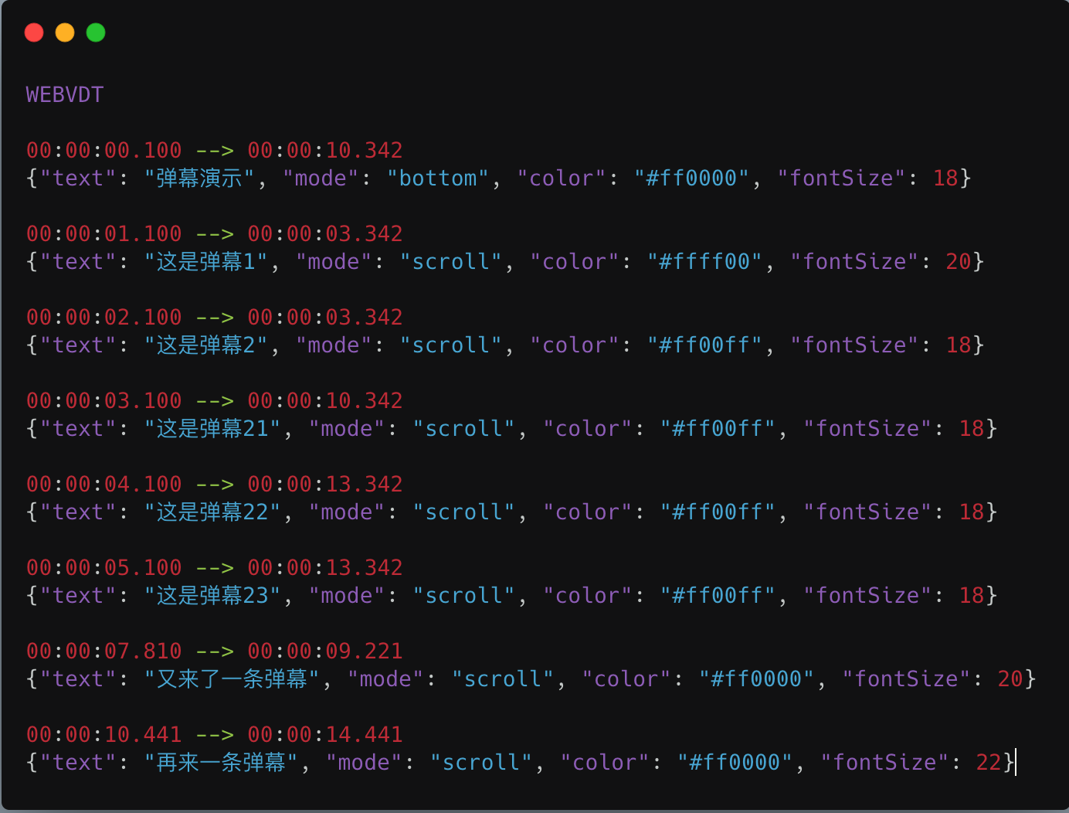
Bullet Curtain – VDT Formats
弹幕 – VDT文件格式
VDT format file refers webVTT, using JSON to describe bullet curtains
VDT: Just like WebVTT, indicating file format
00:00:00.100 --> 00:00:10.100: describing start time and end time of the bullet curtains
描述弹幕的起始时间和结束时间
text: content of the bullets
弹幕内容
mode: Setting fixed position for bullets. “scroll” means text can scroll, “bottom” means text fixed on the bottom, “top” means text fixed on the top
设置弹幕显示模式，是滚动还是固定在视频上方或者下方
color: color for bullets
弹幕颜色
fontSize: fontSize for bullets
弹幕字体大小
danmaku.vdt
POC(Only for Google Chrome)

Slide 9
Bullet Curtain – VDT Formats
弹幕 – VDT文件格式
VDT 文件格式当前只是一种建议，未必是最优的格式化。需要讨论 通过 video中的 track 引入 vdt文件 是否合理？
VDT format file is only a suggestion and is not mature
VDT 中JSON 的数据结构需要重点关注和优化
Discussions are needed, especially for the JSON format for VDT

Slide 10
媒体与娱乐组其它相关用户场景
Other scenarios for MEIG
我们还准备了《Use Cases Discussion for Media and Entertainment Interest Group DRAFT: Version 0.5 》,包含弹幕、超高清视频清晰度切换、多语言字幕、视频打点、VR360全景等用户场景，各位有兴趣的会员，希望我们能联合讨论并一起联名提交！
We drafted《 Use Cases Discussion for Media and Entertainment Interest Group》， including use cases for bullet curtain, HD definition switch, multi-language subtitles, cue events, VR 360 view.
CALL FOR ACTION: Members work together to complete the scenarios definitions!

