Slide 1
Cyber-Physical Graphs vs. RDF graphs
Gilles Privat
Orange Labs,
Grenoble, France

Slide 2
CPS Graphs
Graphs that model (man-made) Cyber-Physical Systems
Have been used long before the Web & RDF ….
Have semantics of their own
  These (operational or structural) semantics apply to the graph as a whole,
  not to individual nodes or arcs
  yet complemtary to per-resource RDF style semantics
CPS graphs should not be subsumed by RDF graphs
  Arcs (→relationships) may need to have properties, without resorting to reification
  Proper structure of the graph should be maintained to
    run graph-theoretic algorithms (e.g. maximal flow)
    perform graph structure analysis (e.g. spectral analysis, degree distribution, etc.)

Slide 3
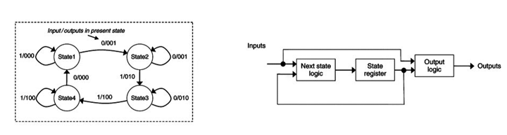
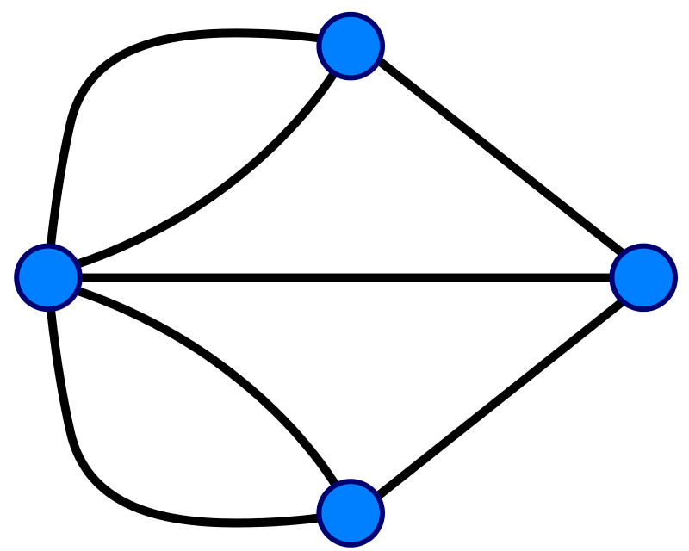
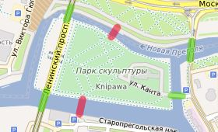
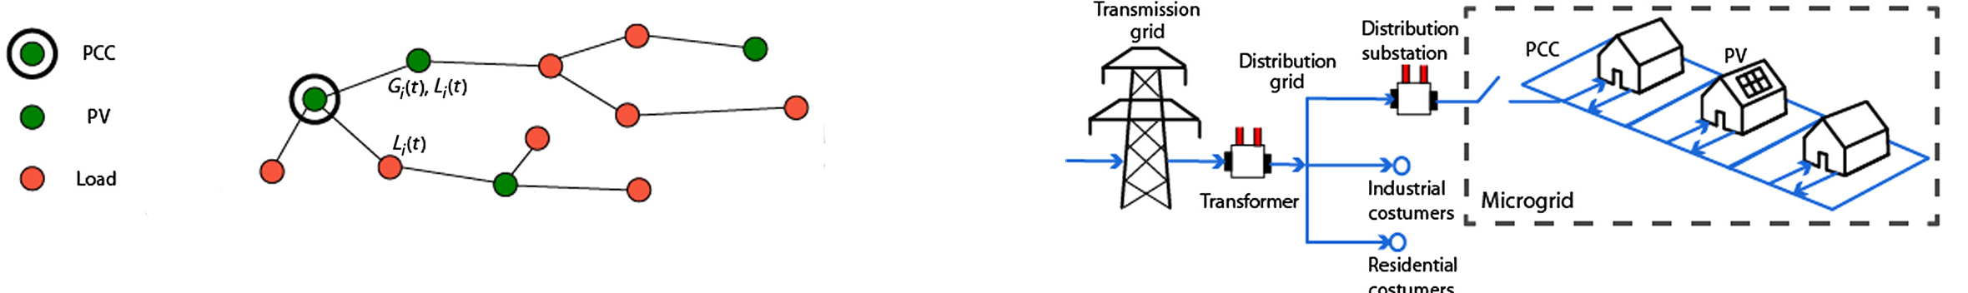
Examples of CPS graphs (1/2) with semantics that is not reducible to RDF-style (referential) semantics
Finite-State Mealy Machine (state-transition graph, operational semantics
Physical network (structural/topological semantics)
  Street network
  Electrical grid
means
means
means

Slide 4
Examples of CPS graphs (2/2)
« Systems of systems » structural description
red
Traffic-lights control System Graph
hasState
Traffic Light TL1
70%
y% congested
isNodeOf
Graph
Surveillance
Camera A1
hasCoverage
hasState
actuatedBy
Traffic management System Graph
monitors
Street A
connectsTo
Traffic
Management
System
Crossing
isNodeOf
Graph
isSub
GraphOf
Smart City
System Graph
open/
closed
hasState
connectsTo
Empty/
Occupied
isNodeOf
Graph
Parking A
Contains
hasState
Parking
management System Graph
hasState
handicapped
parking space AH1
n/N available spaces
Empty/
Occupied
EV fast charger
Parking Management
System
hasState
Contains
EV charging
space AE1
hasPower

Slide 5
CPS graph captured as NGSI-LD property graphs, with RDF/RDFS/OWL semantics as an overlay
DUL:PhysicalObject
DUL:
InformationEntity
SOSA:Actuator
NGSI-LD:
graph
SOSA:Sensor
red
Traffic-lights control System Graph
hasState
Traffic Light TL1
70%
y% congested
isNodeOf
Graph
Surveillance
Camera A1
hasCoverage
hasState
actuatedBy
Traffic management System Graph
monitors
Street A
connectsTo
Traffic
Management
System
Crossing
isNodeOf
Graph
open/
closed
isSub
GraphOf
Smart City
System Graph
hasState
connectsTo
Empty/
Occupied
isNodeOf
Graph
Parking A
Contains
hasState
Parking
management System Graph
hasState
handicapped
parking space AH1
n/N available spaces
Parking Management
System
Empty/
Occupied
EV fast charger
hasState
Contains
hasPower
EV charging
space AE1

Slide 6
Representing complex physical connections
→hyperedges cast as nodes
Crossing C2
Connects
Connects
Crossing C1
Street S1
Connects
Connects
Crossing C3
Connects
Building B1
Parking Lot L1
means
Crossing C3
Crossing C1
Crossing C2
Connects
Building B1
Hyperedge Explicitly
reified AsNode
Parking Lot L1
Street S1

